Slide 1
Secure Data Hiding in Image Using Steganography
CAPSTONE PROJECT
Presented By:
Mudunuri Shrilekha
Computer Science Engineering Department
CMR Institute of Technology

Slide 2
OUTLINE
Problem Statement
Technology used
Wow factor
End users
Result
Conclusion
Git-hub Link
Future scope

Slide 3
Problem Statement
In today's digital age, there is an increasing need for secure communication methods that protect sensitive information from unauthorized access. While encryption provides data security, it can draw attention to the very existence of secret communication. Steganography offers a solution by hiding messages within seemingly ordinary digital content.

Slide 4
Technology used
Python 3.13
Chosen for its extensive libraries and cross-platform compatibility
Core Libraries
GUI Framework - Tkinter
Python's standard GUI library
Used for creating the desktop application interface
ttk module for themed widgets and modern appearance
Provides cross-platform compatibility
Image Processing - OpenCV (cv2)
Handles image reading, manipulation, and writing
Supports multiple image formats (PNG, JPG, JPEG, BMP)
Efficient pixel-level operations for message embedding

Slide 5
Technology used
Cryptography
cryptography.fernet
Implementation of symmetric encryption
Secure message encryption before embedding
Guarantees message confidentiality
cryptography.hazmat.primitives
Low-level cryptographic primitives
PBKDF2HMAC for password-based key derivation
SHA256 for secure hashing

Slide 6
Technology used
Standard Libraries
os
File and path operations
Cross-platform file handling
Directory management
base64
Encoding and decoding of binary data
Used in cryptographic key generation
typing
Type hints for better code documentation
Optional type for nullable values

Slide 7
Wow factors
Optimized Performance
Chunk-Based Processing: Enhances security and efficiency.
Safety Limits: Prevents memory overflow and malicious inputs.
User Convenience
Smart Window & File Management: Auto-centring, clean closures, organized outputs.
Cross-Platform Compatibility:
Works seamlessly on Windows, macOS, and Linux.
Educational & Extensible:
Covers cryptography, image processing, and UI design
Modular codebase that allows future upgrades
Strong Security
Dual-Layer Protection: Encrypts messages before embedding.
Secure Key Derivation: Uses PBKDF2HMAC with SHA256 to prevent attacks.
Modern UX
Polished UI: Professional design with smooth animations.
Smart Feedback: Real-time updates and clear error messages.
Advanced Image Processing
Adaptive Capacity: Prevents overflow, maintains quality
Format Preservation: Supports multiple formats with no visible changes.
Robust Error Handling
Proactive Checks: Ensures compatibility and prevents mistakes.
Recovery Mechanism: Explains failures and suggests fixes.

Slide 8
End users
This steganography project is designed for cybersecurity professionals, privacy-conscious individuals, developers, researchers, law enforcement, and businesses. Security analysts and ethical hackers can use it for secure communication and steganography detection testing, while journalists and activists can protect sensitive information. Developers and academics benefit from exploring cryptography and image processing, and law enforcement agencies can leverage it for digital forensics and covert operations. Businesses can use it to secure confidential data transmission. With its strong encryption, usability, and cross-platform support, this tool serves anyone needing secure, hidden communication.

Slide 9
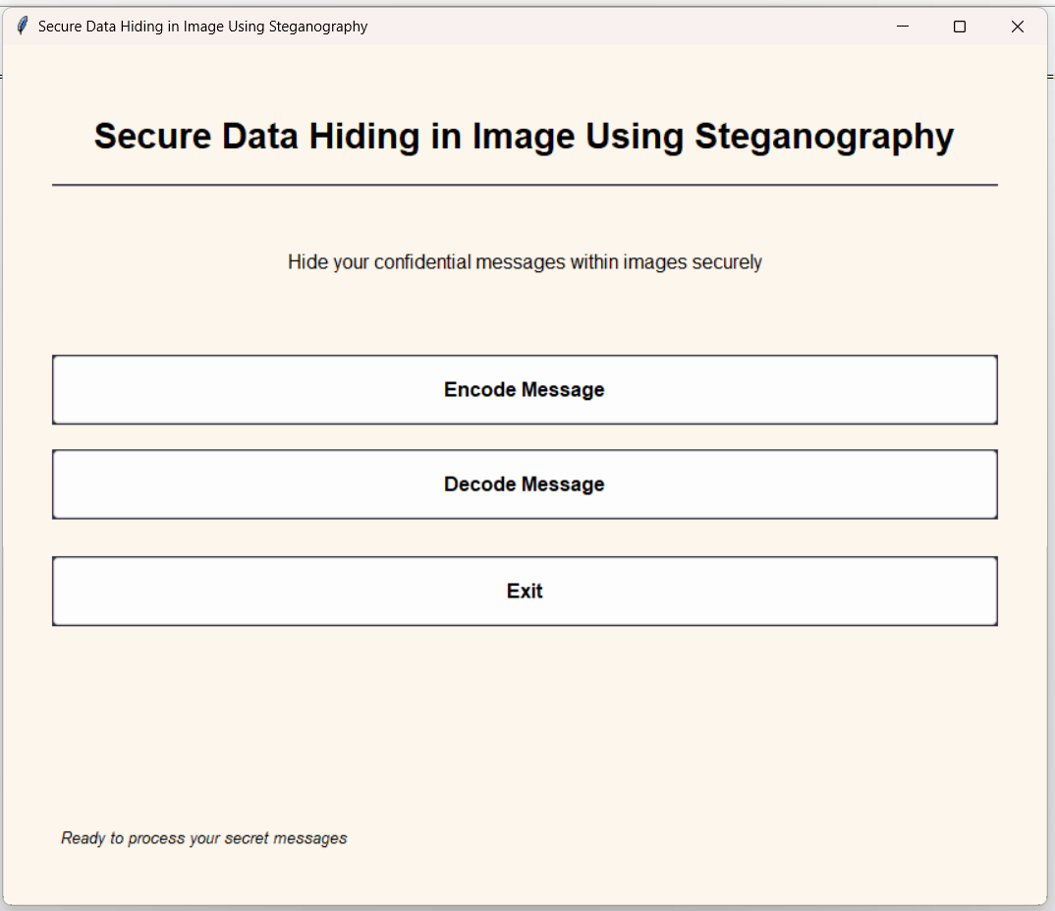
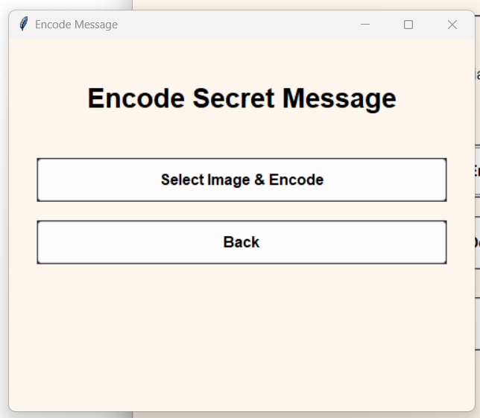
Results
Initial window

Slide 10
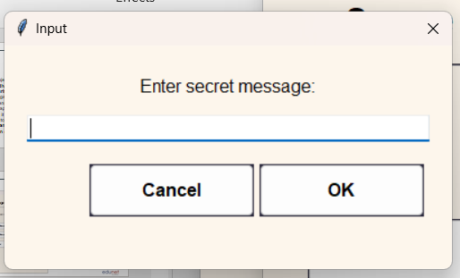
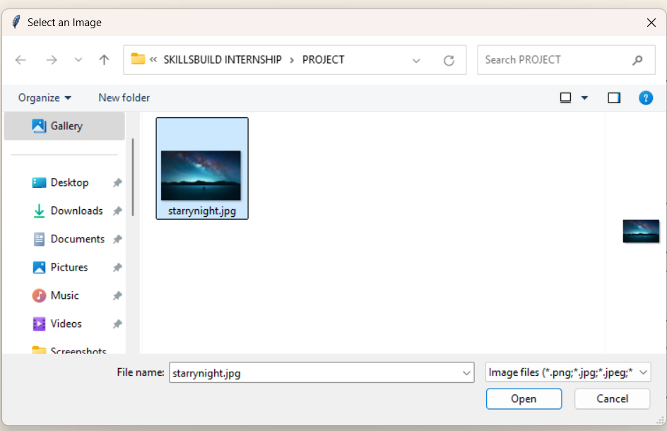
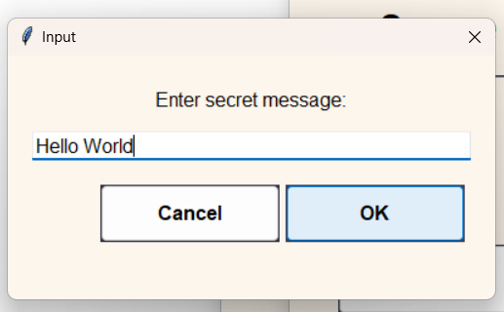
Results
ENCODING/ENCRYPTION

Slide 11
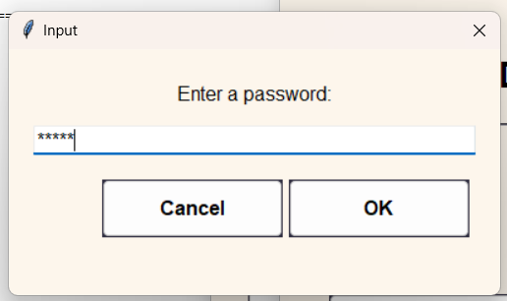
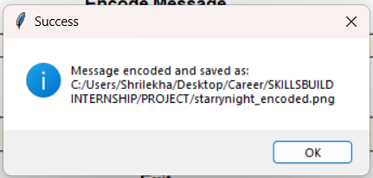
Results
ENCODING/ENCRYPTION

Slide 12
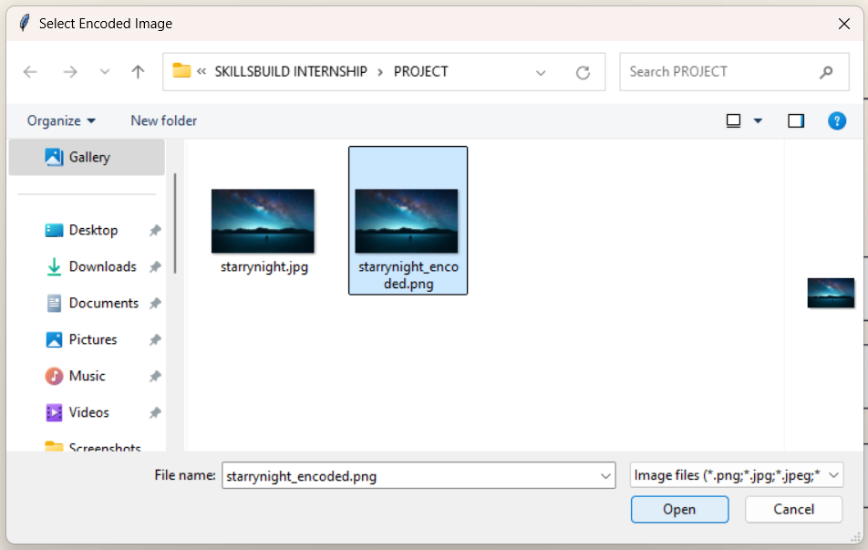
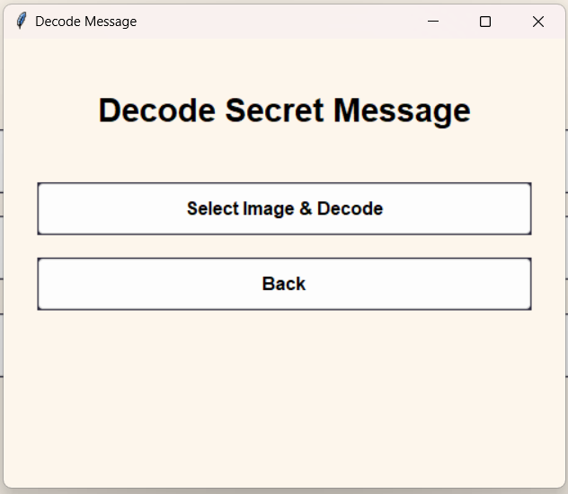
Results
DECODING/DECRYPTION

Slide 13
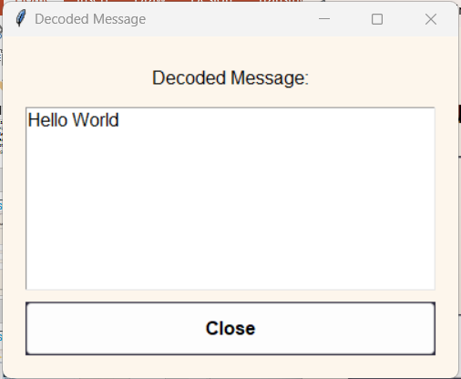
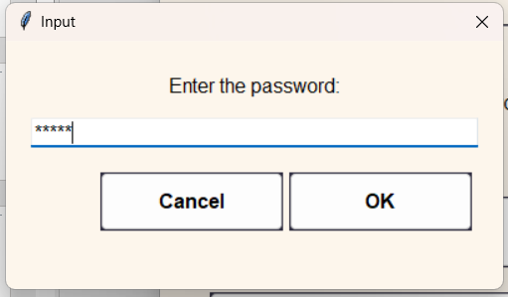
Results
DECODING/DECRYPTION

Slide 14


Results
starrynight.jpg
starrynight_encoded.png

Slide 15
Conclusion
Steganography provides an effective way to secure digital communication by embedding secret messages within seemingly ordinary files. Unlike traditional encryption, which may signal the presence of confidential information, steganography ensures that messages remain undetectable to unauthorized users.
Through the implementation of various steganographic techniques, this project demonstrates the feasibility of concealing and retrieving hidden data without altering the visible properties of digital content. As digital security concerns continue to grow, steganography serves as a valuable tool for covert communication and information protection.

Slide 16
GitHub Link
https://github.com/Shrilekha-369/Steganography.git

Slide 17
Future scope
Enhanced Robustness: Future research can focus on improving steganographic methods to resist attacks such as steganalysis and data corruption.
Increased Capacity: Techniques can be developed to increase the amount of data that can be hidden within an image or other media without degrading quality.
Multi-layer Security: Combining steganography with encryption can provide a more secure approach to data concealment.
Real-time Steganography: Implementing real-time steganographic solutions for secure messaging applications can enhance communication security.
Cross-Media Steganography: Expanding beyond images to include audio, video, and text-based steganography can broaden its practical applications.

Slide 18
Thank you

